Slide 1
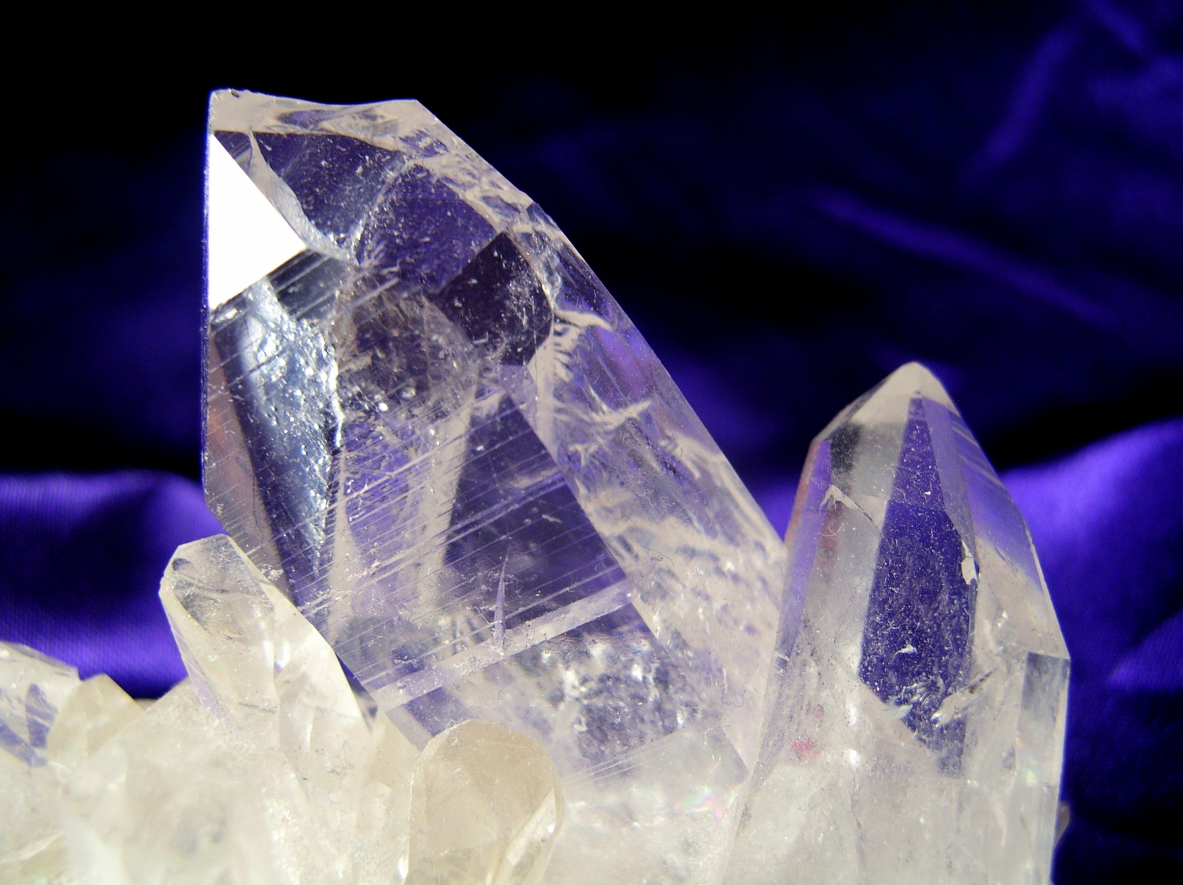
MODERN ORGANIC SYNTHESIS
1. Directed ortho-metalation and related stories
Daniel T. Gryko

Slide 2
General concept
Gilman and Webb 1939
Witting and Fuhrman 1940
Snieckus – 1970-now.

Slide 3
Mechanistic aspects

Slide 4
Cooperative effect

Slide 5
Electrophiles

Slide 6
Electrophiles

Slide 7
Heterocyclic amides

Slide 8
Tertiary O-carbamates

Slide 9
Tertiary O-carbamates
Anionic equivalent of ortho-Fries rearrangement

Slide 10
Tertiary O-carbamates

Slide 11
Tertiary O-carbamates

Slide 12
2,6-Dianion equivalents

Slide 13
Methyl, allyl and formyl

Slide 14
Ortho-hydroxyalkylation

Slide 15
Anthraquinones

Slide 16
Polycyclic aromatic hydrocarbons

Slide 17
Heteroatoms – N, S

Slide 18
Heteroatoms – Si, Sn, B

Slide 19
Special examples

Slide 20
LiCl-promoted insertion of Mg and Zn

Slide 21
Preparation of Mg and Zn organometallic reagents via halogen-Mg exchange

Slide 22
Site-selective deprotonation with metallic TMP-bases

Slide 23
Site-selective deprotonation with metallic TMP-bases

Slide 24
Frustrated Lewis Acid - Lewis Base Pairs

Slide 25
Solid air-stable organozinc reagents

Slide 26
Solid air-stable organozinc reagents

Slide 27
Solid air-stable organozinc reagents

Slide 28
Key literature
V. Snieckus, Chem. Rev. 1990, 90, 879.
P. Knochel, J. Org. Chem. 2014, 79, 4253
P. Knochel, Synthesis, 2017, 49, 3215.

