Slide 1
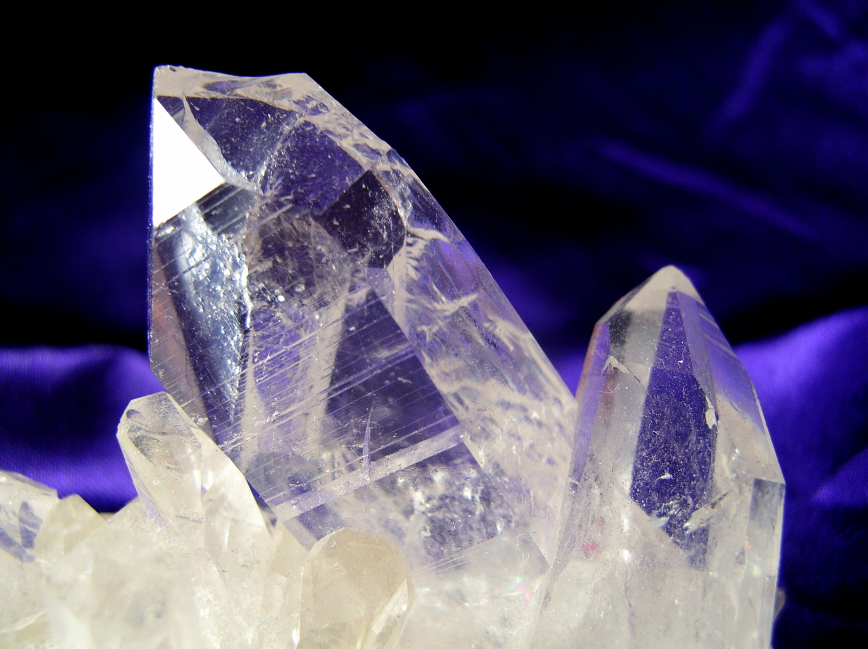
MODERN ORGANIC SYNTHESIS
7. F, CF₂H, CF₃
Daniel T. Gryko

Slide 2
Fluorinated compounds around us

Slide 3
Classic methods

Slide 4
Redox potentials of fl.-reagents (vs. SCE)

Slide 5
From Grignard reagents

Slide 6
N-directed fluorination

Slide 7
AgF₂ and XeF₂

Slide 8
SnBu₃ → F

Slide 9
Enantioselective…

Slide 10
Double bonds – fluorination/nucleophile addition

Slide 11
Radical

Slide 12
Nucleophilic fluorination

Slide 13
Nucleophilic deoxyfluorination

Slide 14
CF₂

Slide 15
CF₃ -electrophilic

Slide 16
CF₃ -electrophilic

Slide 17
CF₃ -electrophilic

Slide 18
CF₃ -nucleophilic

Slide 19
CF₃ -nucleophilic

Slide 20
CF₃CF₂

Slide 21
CF₃O

Slide 22
CF₃S

Slide 23
Difluoroalkenes

Slide 24
Key literature
T. Ritter Angew. Chem. Int. Ed. 2013, 52, 8214.
Additional literature
J. F. Hartwig Science 2013, 342, 956.

