Slide 1
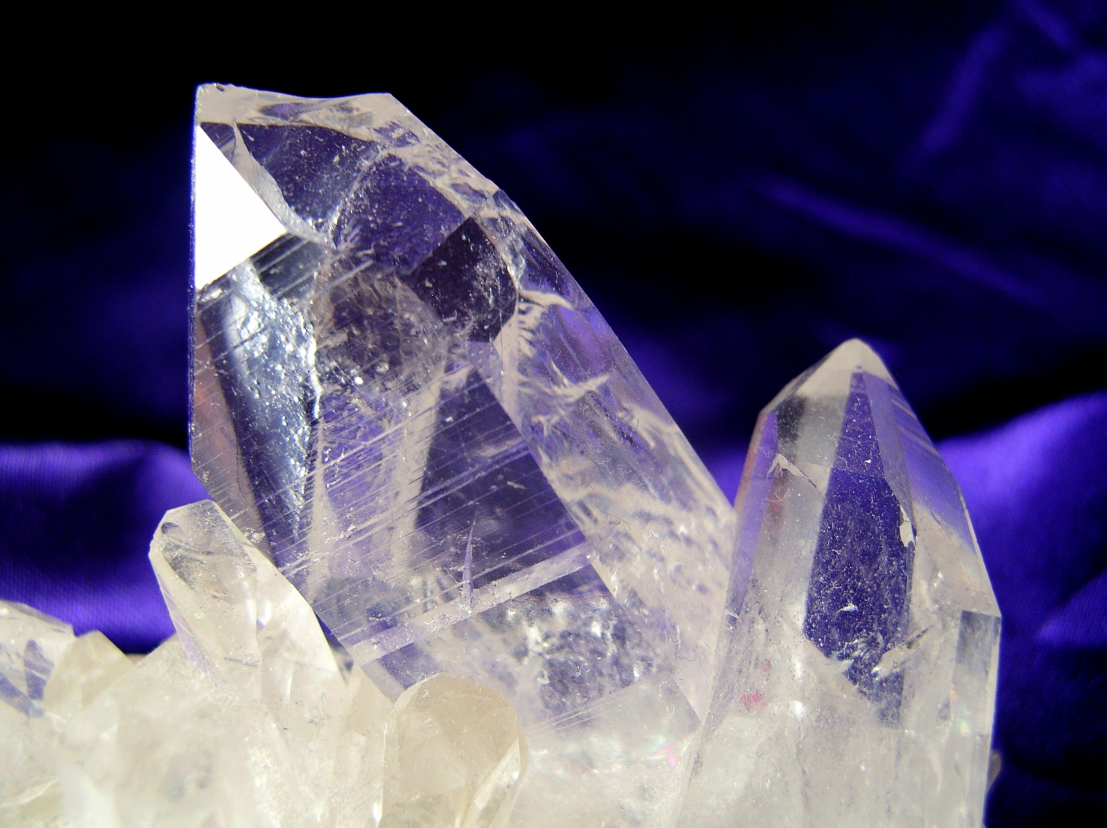
MODERN ORGANIC SYNTHESIS
2. Directed C-H functionalization Part I
Daniel T. Gryko

Slide 2
General idea

Slide 3
Co - hydroarylation reactions

Slide 4
Co - hydroarylation reactions

Slide 5
Co

Slide 6
Proposed mechanism for the hydroarylations

Slide 7
Co

Slide 8
Co

Slide 9
Co

Slide 10
Co

Slide 11
Co

Slide 12
Co

Slide 13
Manganese-catalyzed C-H activation

Slide 14
Mn-catalyzed C-H activation

Slide 15
Mn-catalyzed C-H activation

Slide 16
Mn-catalyzed C-H activation

Slide 17
Mn-catalyzed C-H activation

Slide 18
Mn-catalyzed C-H activation

Slide 19
Mn-catalyzed C-H activation

Slide 20
8-Aminoquinoline

Slide 21
8-Aminoquinoline

Slide 22
8-Aminoquinoline

Slide 23
8-Aminoquinoline

Slide 24
8-Aminoquinoline

Slide 25
8-Aminoquinoline

Slide 26
8-Aminoquinoline

Slide 27
8-Aminoquinoline – how to remove?

Slide 28
Key literature
L. Ackermann, ACS Cat. 2016, 6, 3743.
L. Ackermann, ACS Cat. 2016, 6, 498.
M. Schnurch, Chem. Soc. Rev., 2018, 47, 6603.

