Slide 1
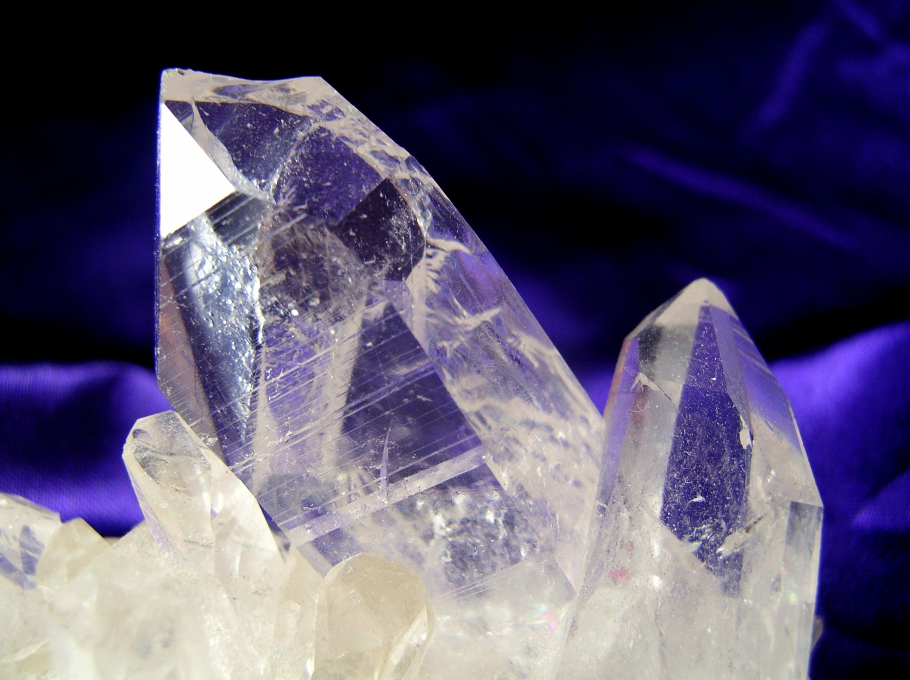
MODERN ORGANIC SYNTHESIS
3. Directed C-H functionalization + Direct Arylation
Daniel T. Gryko

Slide 2
COOH

Slide 3
COOH

Slide 4
COOH

Slide 5
COOH

Slide 6
Remote site –selective C-H activation

Slide 7
Remote site–selective C-H activation

Slide 8
General idea

Slide 9
Furanes

Slide 10

Thiophenes

Slide 11
Pyrroles

Slide 12
Indoles

Slide 13
Mechanistic considerations

Slide 14
Pyridine

Slide 15
Pyridine N-oxides

Slide 16
Intramolecular versions

Slide 17
Intermolecular competition experiments

Slide 18
Oligofluorinebenzenes – K. Fagnou

Slide 19
Special role of pivaloate

Slide 20
Why pivaloate??

Slide 21
Pivalate-assisted direct arylation of electron-rich arenes

Slide 22
Arylation with tosylates

Slide 23
Intramolecular sp³ activation

Slide 24
Effect of Cocatalytic Additives

Slide 25
Monoarylation of triazol-4-yl substituted arenes

Slide 26
Arylations

Slide 27
Direct arylation with phenols

Slide 28
Alkylation and benzylation

Slide 29
Test

Slide 30
Key literature
L. Ackermann, Chem. Rev. 2011, 111, 1315.
M. Schnurch, Chem. Soc. Rev., 2018, 47, 6603.
R. Rossi, Adv. Synth. Cat. 2014, 356, 17.
Jin-Quan Yu, Nature, 2017, 543, 538.

