Slide 1
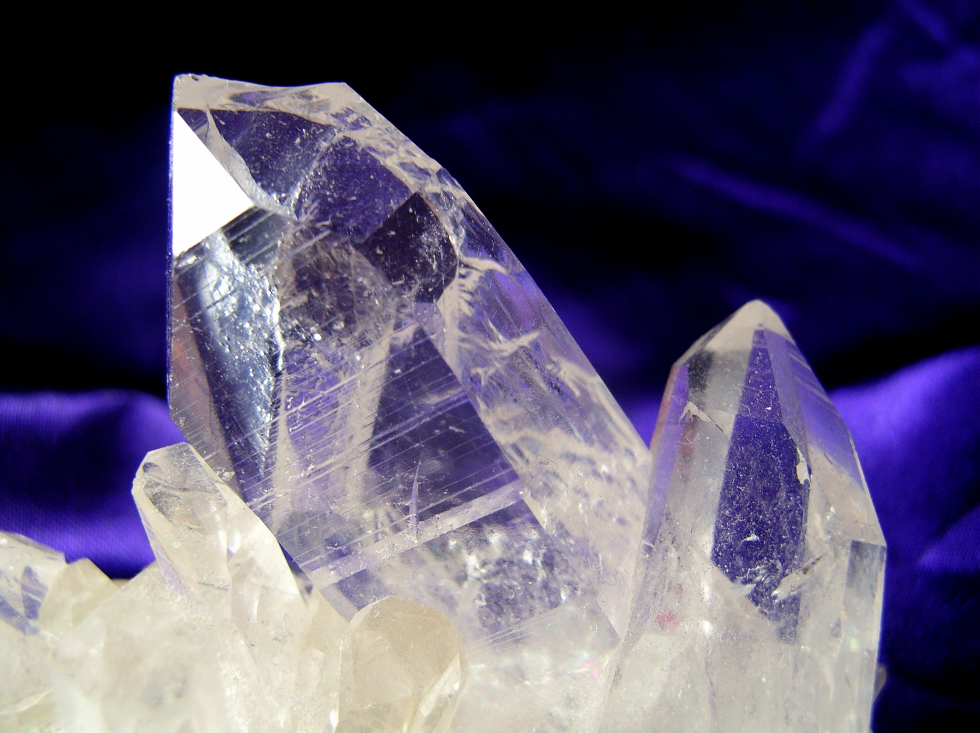
MODERN ORGANIC SYNTHESIS
4. Nucleophilic Substitution of Hydrogen in the Synthesis of Aromatic Heterocyclic Compounds
+
Modern Oxidation
Daniel T. Gryko

Slide 2
Nucleophilic substitution of hydrogen - mechanism

Slide 3
Vicarious nucleophilic substitution of hydrogen - mechanism

Slide 4
Oxidative

Slide 5
Indole

Slide 6
Indole

Slide 7
Indole

Slide 8
Indole

Slide 9
Indole

Slide 10
Indole – natural products

Slide 11
Indazole and 2,1-Benzisoxazole

Slide 12
Quinoline

Slide 13
Quinoline

Slide 14
Quinoline

Slide 15
Fused quinolines

Slide 16
Fused quinoxalines

Slide 17
Quinoxalines

Slide 18
Alkylation

Slide 19
Aldehydes

Slide 20
Dess-Martin Periodinane

Slide 21
IBX

Slide 22
TEMPO

Slide 23
MnO₂ and BaMnO₄

Slide 24
NaClO

Slide 25
Sodium chlorite - NaClO₂

Slide 26
Ru

Slide 27
DMSO

Slide 28
NaWO₄

Slide 29
Methyltrioxorhenium (MTO) MeReO₃

Slide 30
Key literature
M. Mąkosza Chem. Rev. 2004, 104, 2631.
M. Mąkosza, Synthesis, 2011, 2341.
M. Mąkosza, Heterocycles, 2014, 88, 75.
Additional literature
J. M. Joo Asian JOC. 2015, 4, 1386.

