Slide 1
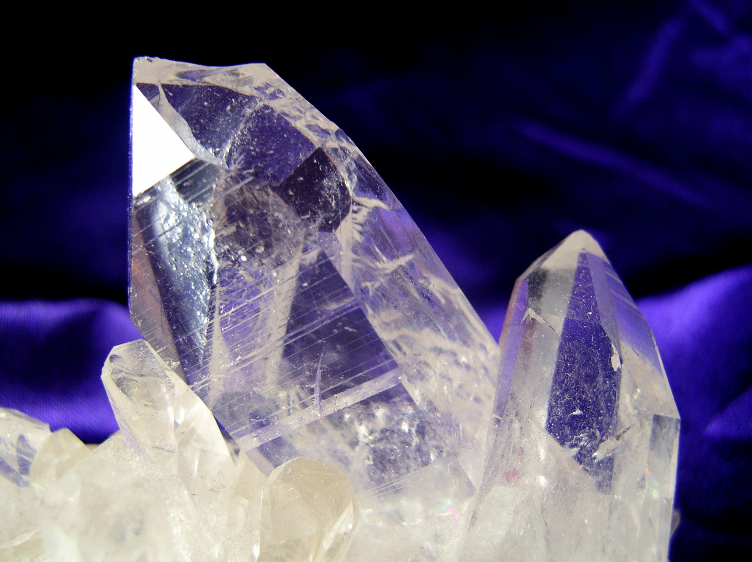
MODERN ORGANIC SYNTHESIS
5. Modern Reduction + Frustrated Lewis Pairs + Micelles
Daniel T. Gryko

Slide 2
LiAlH₄

Slide 3
LiBH₄

Slide 4
Borane complexes

Slide 5
RCOOR →RCHO DIBAL

Slide 6
RCOOR →RCHO LTEAH

Slide 7
Reductants - comparison
 | Iminium ions | Acid chloride | Aldehyde | Ester | Amide | Carboxylate salt
LiAlH ₄ | + | + | + | + | + | +
DIBAL |  | + | + | + | + | +
NaAlH(O-t-Bu)₃ |  | + | + | + | +
AlH₃ |  | + | + | + | + | +
NaBH₄ | + |  | +
NaCNBH₃ | + |  | +
Na(AcO)₃BH | + |  | + | + | +
B₂H₆ |  |  | + | + (slow) | + | +
Li(Et)₃BH |  | + | + | + | +
H₂ cat | + | + | + | + | +
LAB |  |  | + | + | +

Slide 8
COCl → CHO

Slide 9
RCONR₂ → RCH₂NR₂

Slide 10
RCOR → RCH₂R

Slide 11
NaBH₄ + additives

Slide 12
Ionic hydrogenation

Slide 13
RCN → RCH₂NH₂

Slide 14
Barton deoxygenation

Slide 15
Diazene-mediated deoxygenation

Slide 16
Barton decarboxylation

Slide 17
Corey-Winter olefination

Slide 18
Frustrated Lewis Pairs

Slide 19
Frustrated Lewis Pairs

Slide 20
Frustrated Lewis Pairs

Slide 21
Frustrated Lewis Pairs

Slide 22
Frustrated Lewis Pairs

Slide 23
Frustrated Lewis Pairs

Slide 24
Frustrated Lewis Pairs

Slide 25
Frustrated Lewis Pairs

Slide 26
Lipshutz and reactions in micelles

Slide 27
Lipshutz and reactions in micelles

Slide 28
Suzuki (MIDA)

Slide 29
Couplings

Slide 30
Micelles

Slide 32
Key literature
D. W. Stephan Angew. Chem. Int. Ed. 2015, 54, 6400.
B. H. Lipshutz Green Chem. 2014, 16, 3660.
B. H. Lipshutz J. Org. Chem. 2017, 82, 2806.

